Slide 1
ClimbCode

Slide 2

Our Path Today
The Workgroup
Idea & MVP
Business and costs
Work Methodology
2

Slide 3
The Workgroup

Slide 4
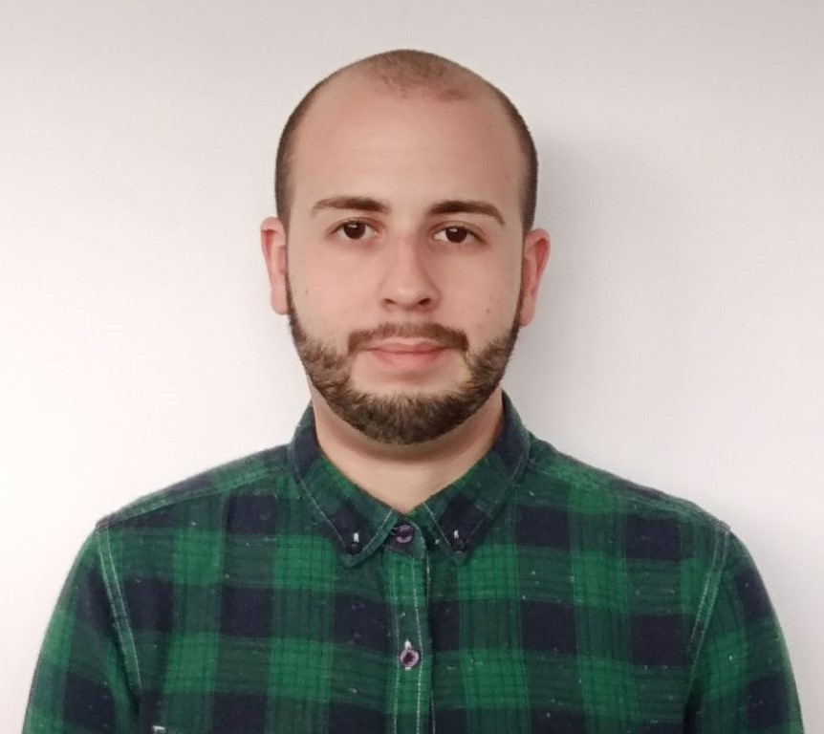

The Workgroup
Miguel Ángel Baños Carretón: Software Engineer
Álvaro Domínguez Núñez: Business Manager
4

Slide 5
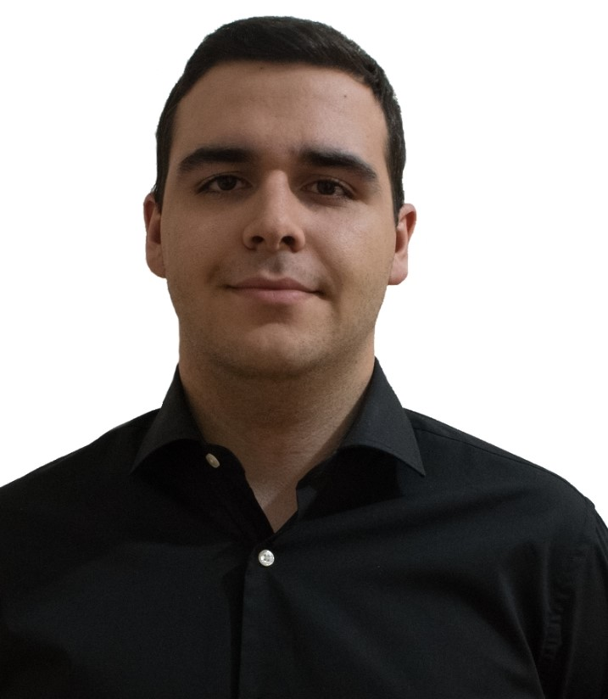
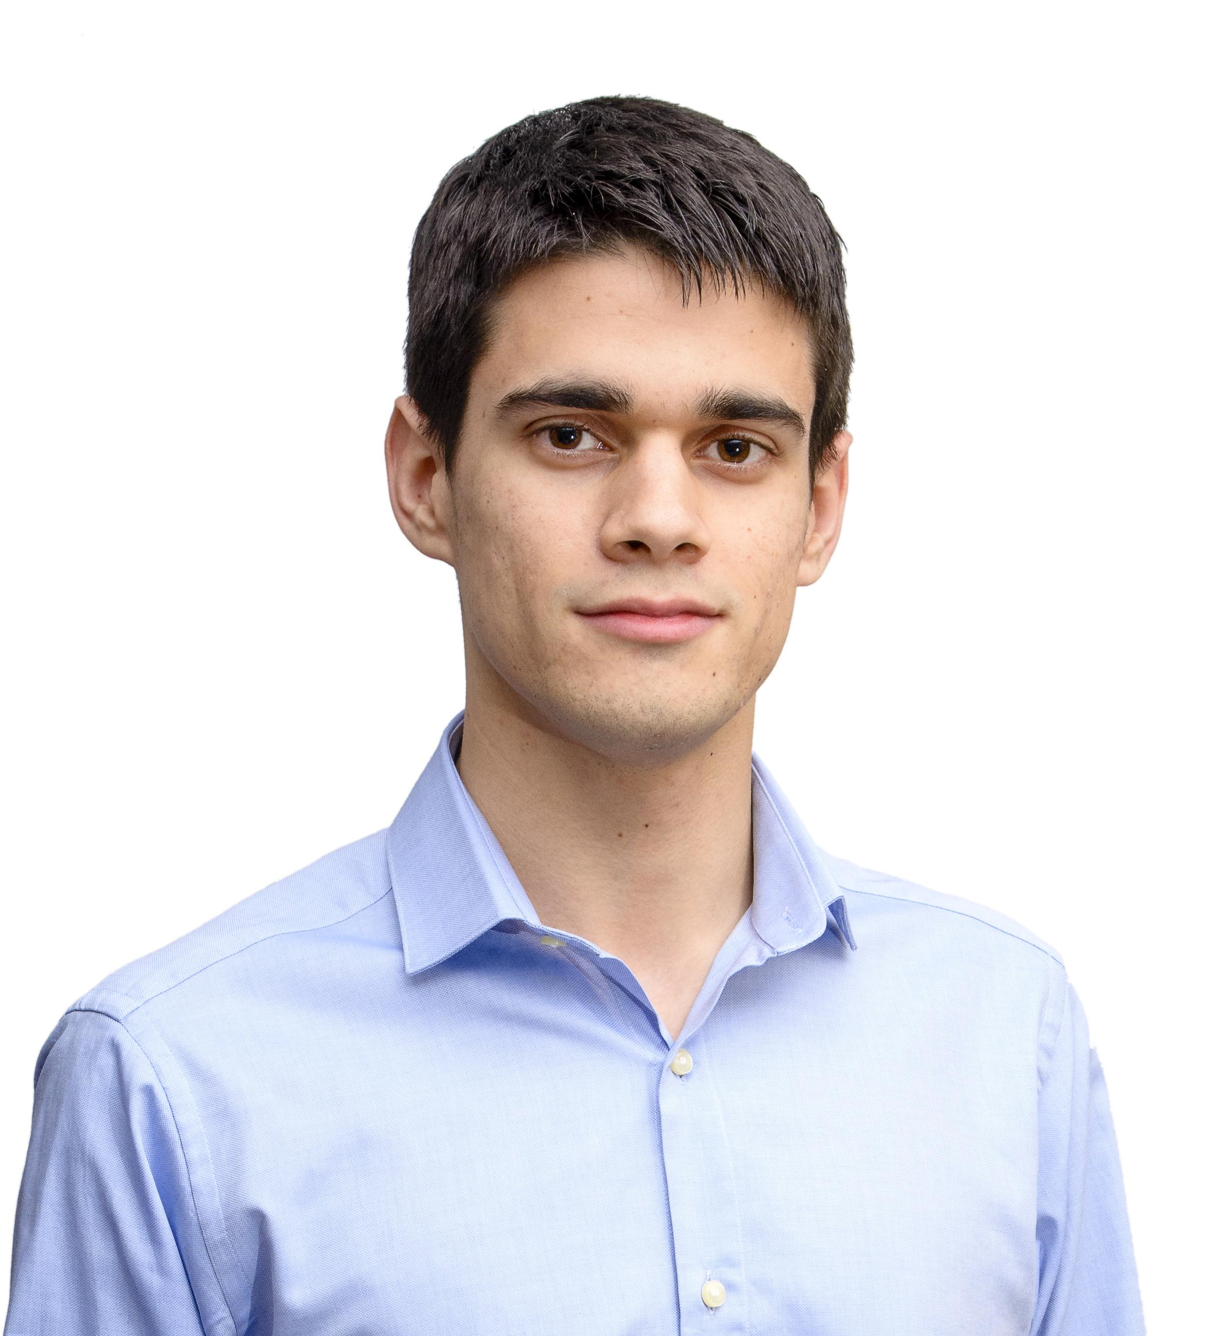
The Workgroup
Andrés Fernández Alés: Software Engineer
Alejandro Garrido Resina: Software Engineer
5

Slide 6
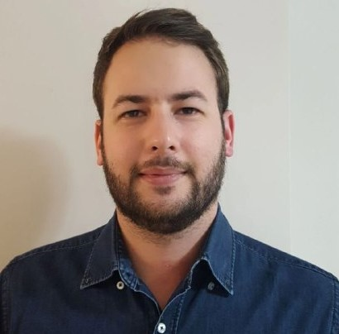
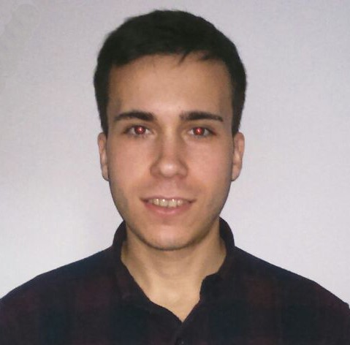
The Workgroup
Alejandro Román Rodríguez:
Project Manager
Álvaro Sánchez López: Software Engineer
6

Slide 7
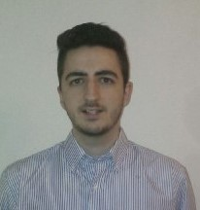

The Workgroup
Jesús Sosa Sánchez: Software Engineer
7

Slide 8
Idea & MVP

Slide 9
Idea & MVP
=
+
ClimbCode
9

Slide 10


Idea & MVP
=
+
10

Slide 11

Learn Programming?
11

Slide 12
12

Slide 13


Idea & MVP
Administrator:
13

Slide 14
Idea & MVP
School:
14

Slide 15

Idea & MVP
Teacher:
15

Slide 16
Idea & MVP
Student:
16

Slide 17
Idea & MVP
Programmer:
17

Slide 18
Let’s have a look
18

Slide 19
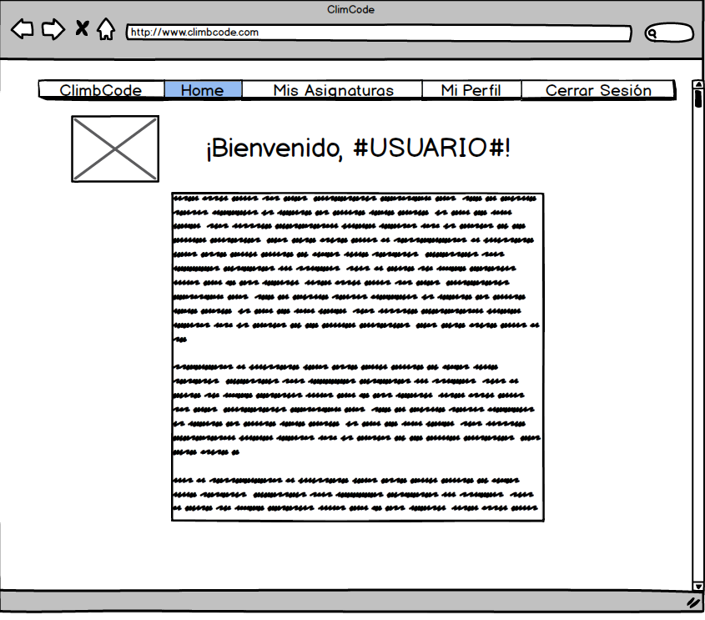
19

Slide 20
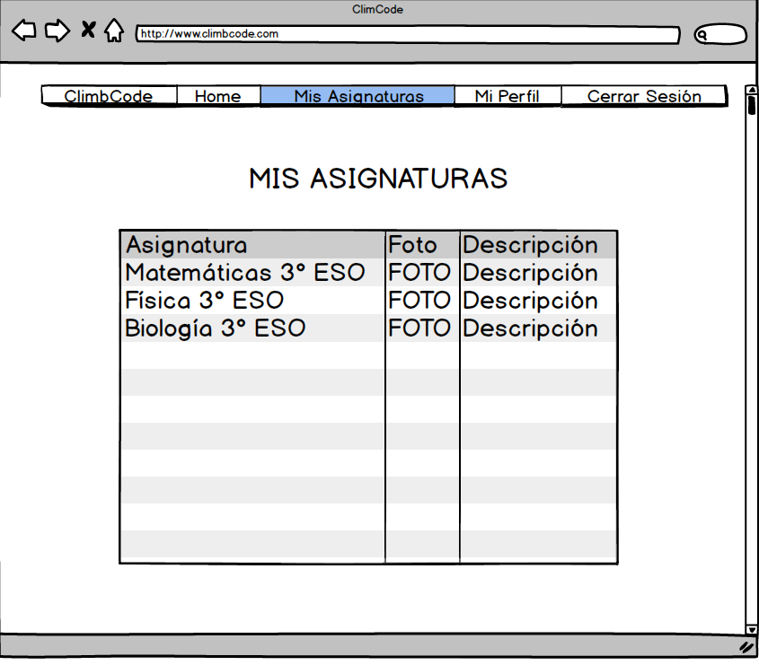
20

Slide 21
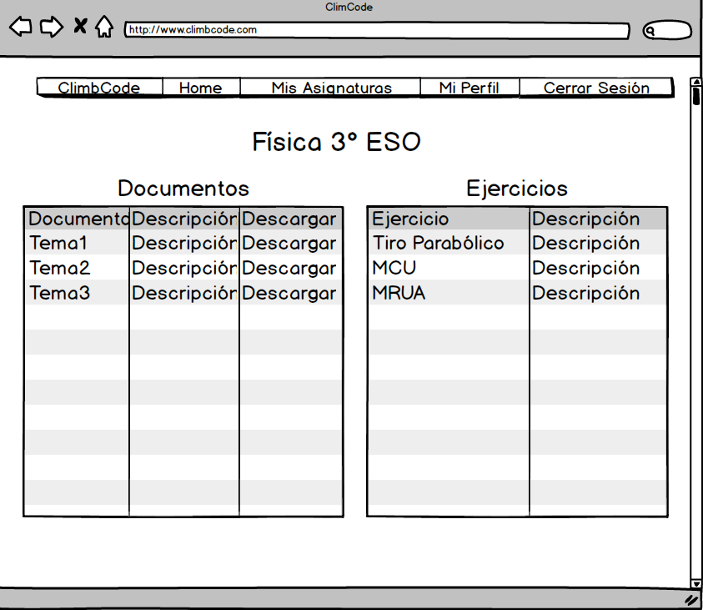
21

Slide 22
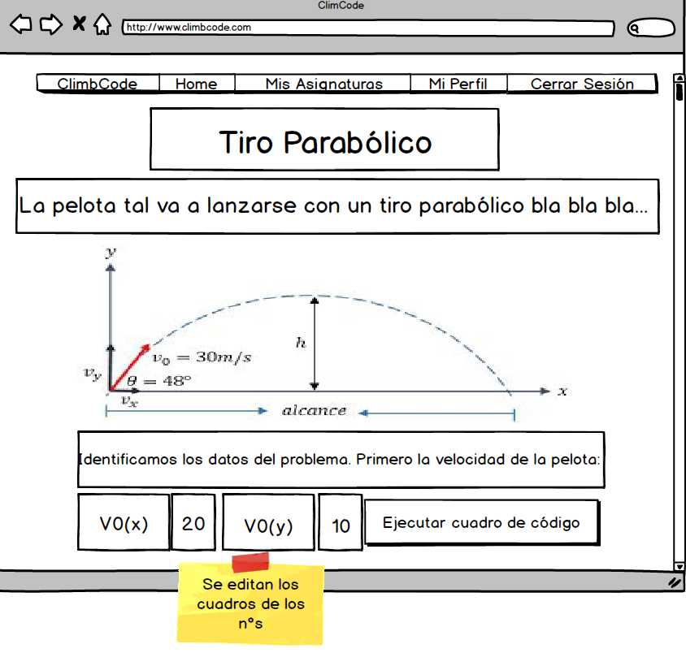
22

Slide 23
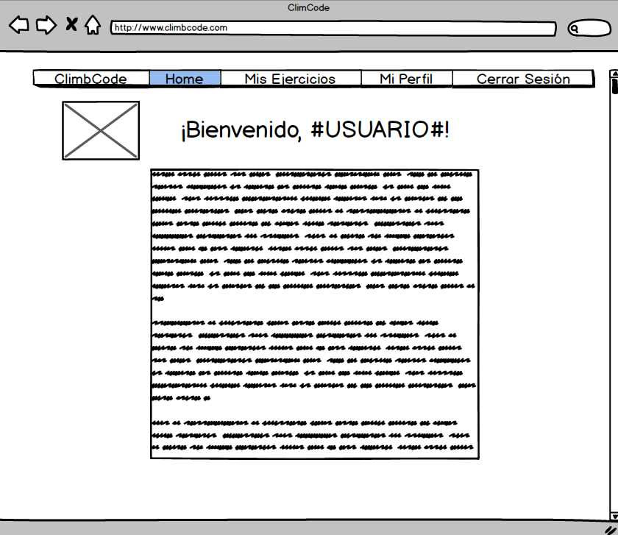
23

Slide 24
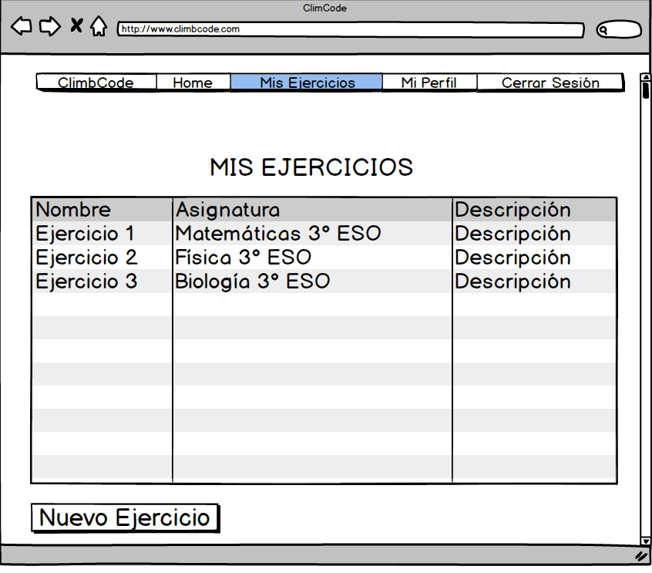
24

Slide 25
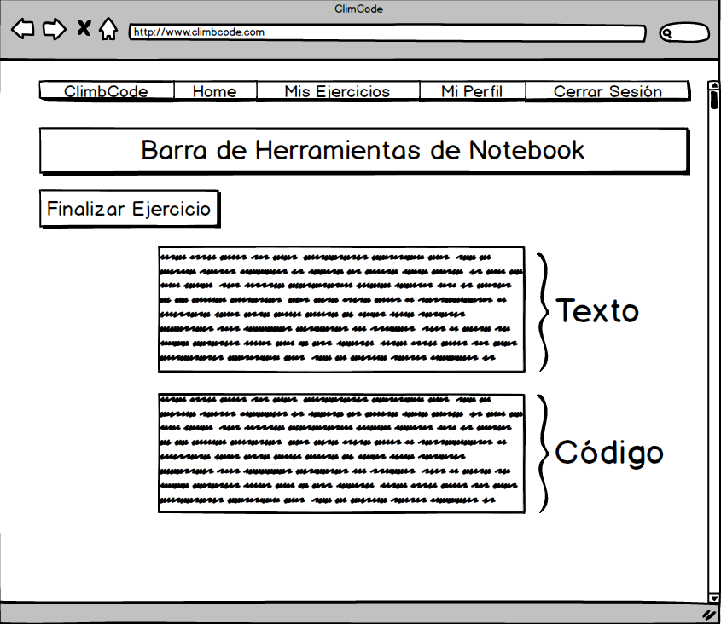
25

Slide 26





Idea & MVP
26

Slide 27


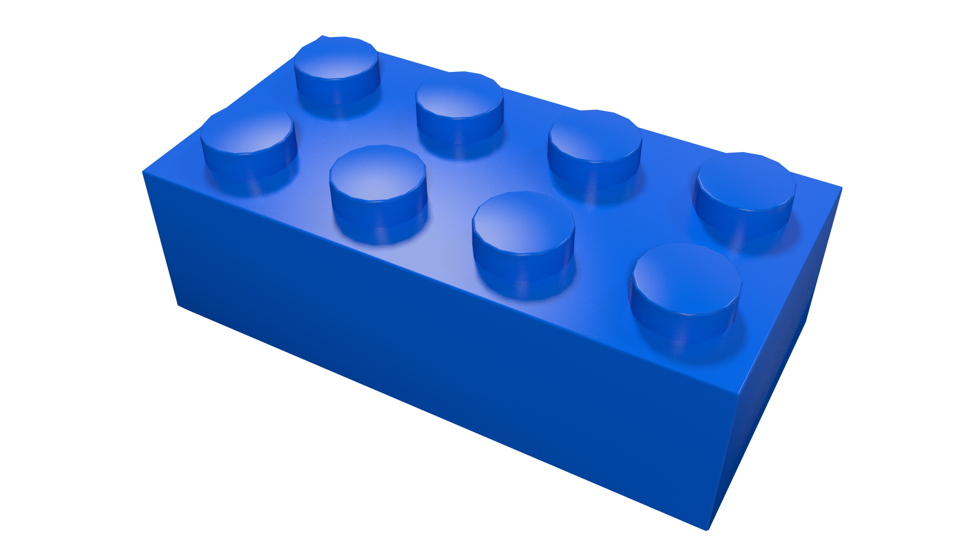

Idea & MVP
27

Slide 28
Business and Costs

Slide 29
Education
29

Slide 30
Is it worth it?
30

Slide 31
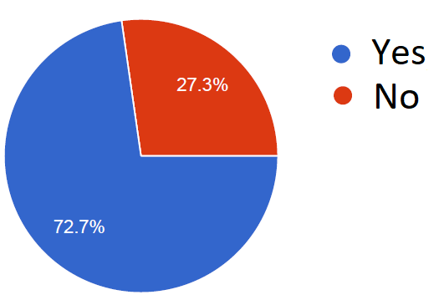
Business and Costs
From 88 people: Related to teaching
31

Slide 32
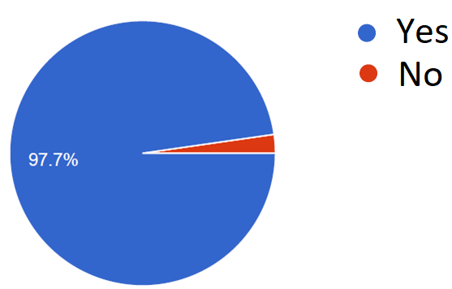
Business and Costs
From 88 people: Thoughts about programming
32

Slide 33
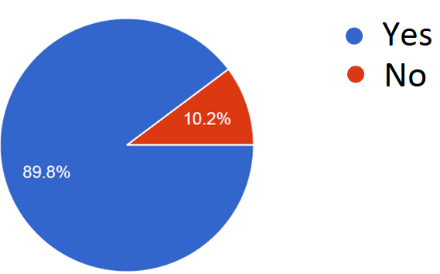
Business and Costs
From 88 people: Want a tool for programming at school
33

Slide 34
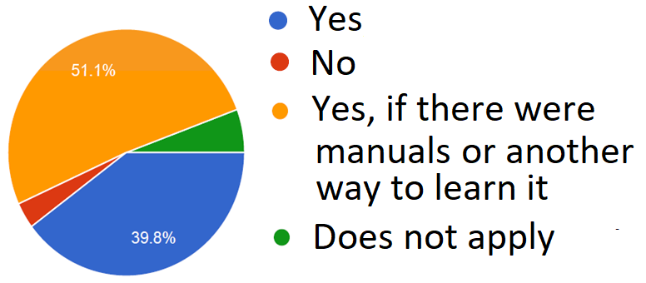
Business and Costs
From 88 people: Would use the tool
34

Slide 35
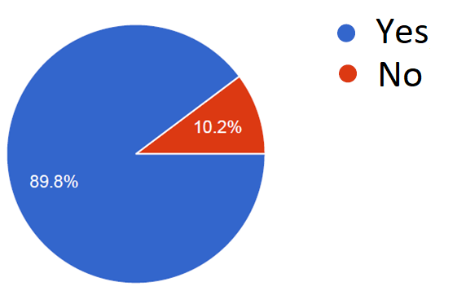
Business and Costs
From 88 people: Thoughts about students
35

Slide 36
How much?
36

Slide 37
Business and Costs
Direct Costs: 3700 €/m
Indirect Costs: 4750 €/m
Amortizations: 800 €/m
37

Slide 38
Business and Costs
9250 €/m
37000 € + 4000 € = 41000 €
38

Slide 39
Business and Costs
39

Slide 40
Business and Costs
40

Slide 41
41

Slide 42

Business and Costs
42

Slide 43
Business and Costs
%
43

Slide 44
Work Methodology

Slide 45

Work Methodology
SCRUM: Three Sprints.
45

Slide 46

Work Methodology
Sprint 1:
46

Slide 47
Work Methodology
Future Sprints:
47

Slide 48



Work Methodology
Development:
48

Slide 49


Work Methodology
Knowledge:
49

Slide 50

THANKS!
You can find me at
alvdomnun@alum.us.es
50

